Slide 1
D-STAR
Mark, KE8BZW

Slide 2
OVERVIEW
Introduction
History, Hardware
Pictures, Chat, Location
Simplex, Repeaters, Hotspots
Local, Linking, Reflectors
Cross-mode
Summary & Q&A

Slide 3
INTRODUCTION
I’m Mark, KE8BZW and I’ve been experimenting with D-STAR since 2019.
My first D-STAR radio was an ID-51A PLUS2 followed by an ID-5100A, an IC-705, and most recently, an ID-52A.
I’m hoping to inspire folks to get to know the capabilities of their D-STAR radios to join me on the air.

Slide 4
What is D-STAR
Digital Smart Technologies for Amateur Radio. It is an open standard digital communication protocol established by JARL (Japan Amateur Radio League) in the late 90’s.
Icom and Kenwood radios support it, along with some hotspots.

Slide 5
DIFFERENT TYPES OF D-STAR Communications
A D-STAR mini-repeater that connects your station to gateways or reflectors
SIMPLEX
Transceiver to transceiver with no repeater in the middle
LOCAL CQ
Local repeater discussion, without use of Internet gateway
GATEWAY CQ
Repeater to repeater discussions
Like a chatroom for a local, regional, or global audience
HOTSPOTS
REFLECTORS

Slide 6
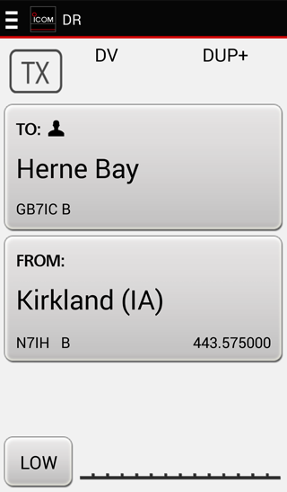
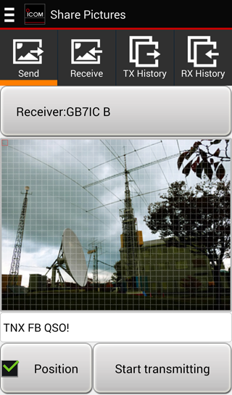
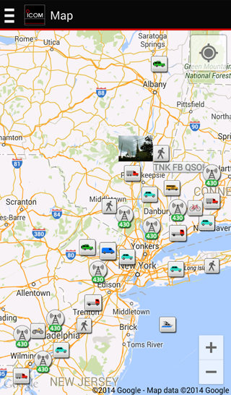
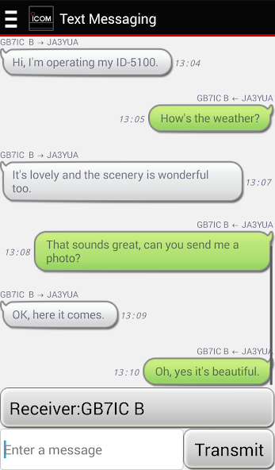
D-STAR CAPABILITIES
DR
SHARE PICTURES
MAP
TEXT MESSAGING
Remote Control Software
Send/receive images
See repeaters and stations
More subtle than voice

Slide 7
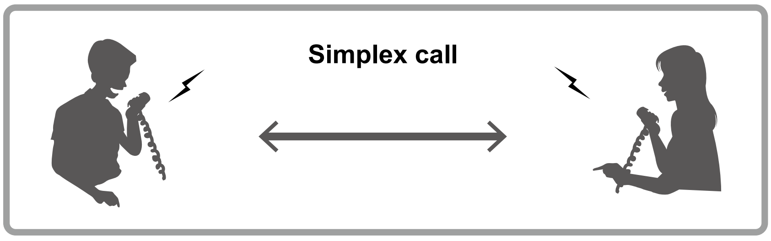
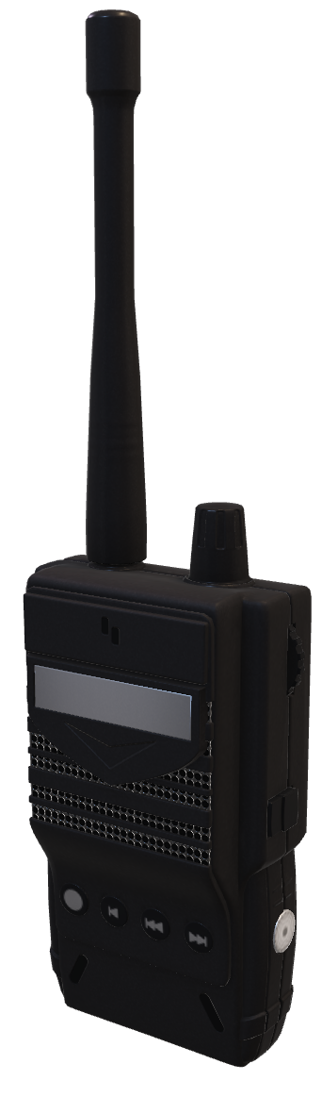
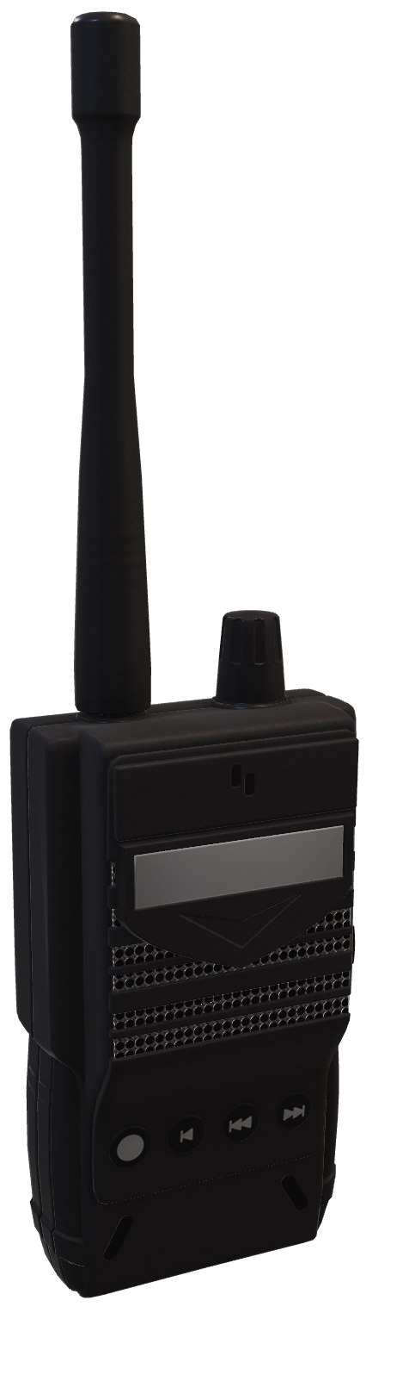
D-STAR SIMPLEX
After setting your callsign, simply tune to…
145.670
Enable DV mode
This is the National D-STAR Simplex Calling Frequency also try 145.600, 441.000, and 445.670

Slide 8
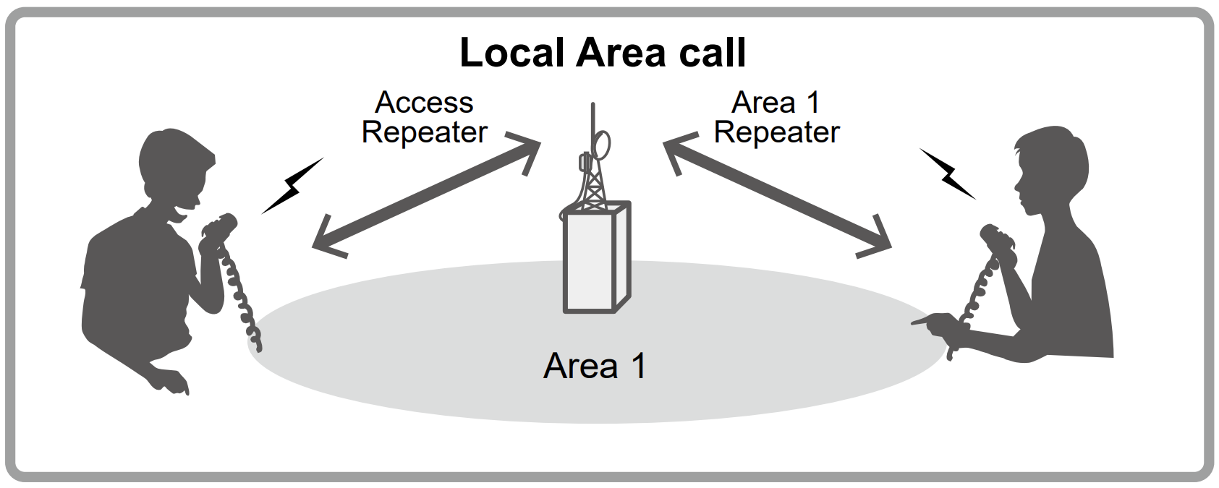
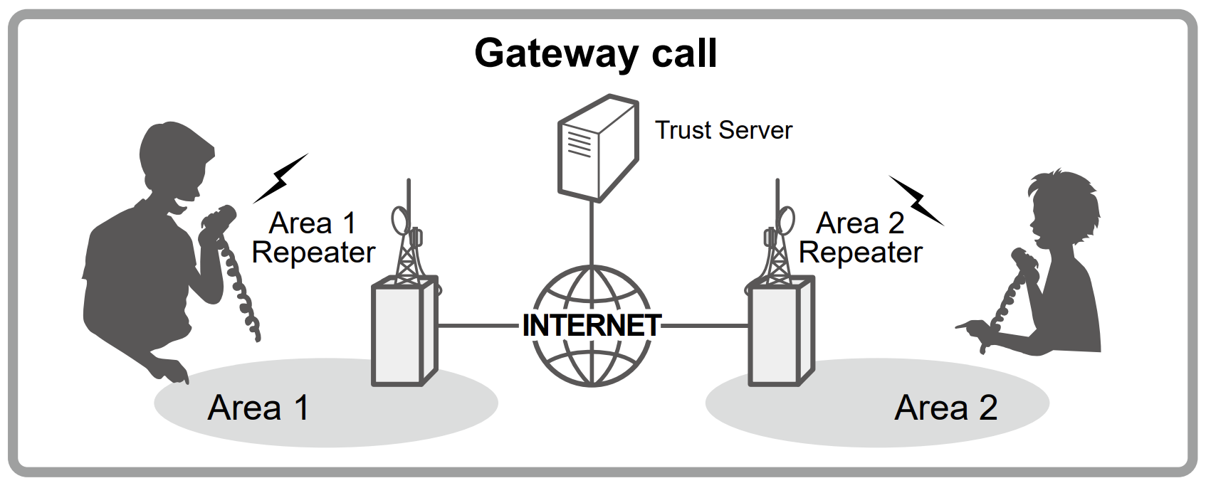
REPEATERS: LOCAL & INTERNET GATEWAY
TO: CQCQCQ
TO: N7IH B
FROM: W8CMH B
FROM: W8CMH B

Slide 9
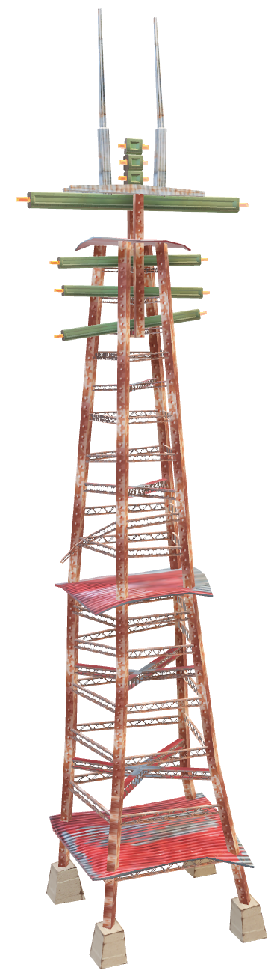
LOCAL D-STAR REPEATERS
W8CMH B/C
Repeater Detail
http://www.dstarusers.org/viewrepeater.php?system=W8CMH
DPLUS Dashboard
https://w8cmh.no-ip.org/ (Gateway Temporarily Offline)
W8DIG A/B/C
Repeater Detail
https://www.dstarusers.org/viewrepeater.php?system=W8DIG
NOTE: C-node voice seems to be outbound only
W8LT B (Offline)
Repeater Detail
https://www.dstarusers.org/viewrepeater.php?system=W8LT

Slide 10
GATEWAY REGISTRATION
Check here: https://regist.dstargateway.org/regcheck/index.php
Registration with a gateway is your key to long-range communications with
D-STAR. If it’s not working for you, check your registration above first.
Register here if you have no local registration gateway repeater:
https://regist.dstargateway.org/Dstar.do

Slide 11
GATEWAY CQ
1
Gateway Repeaters
2
Terminal Mode
(IC-705 or RS-MS3A / RS-MS3W app with cable)
3
Doozy
(Windows app by PA7LIM)
4
D-STAR Hotspot

Slide 12
TERMINAL / HOTSPOT GATEWAYS
APPS & SOFTWARE
HARDWARE HOTSPOTS
Built-in to the IC-705
RS-MS3A app for Android
Doozy app for Windows
Free (TANSTAAFL)
Uses existing processors in existing device
A microprocessor that interfaces RF to the D-STAR network
A separate device
Separate power supply
Updates and configuration
Often cross-mode

Slide 13
REFLECTORS
REF001C
D-STAR's MegaRepeater
(Worldwide) 🌐
REF030C
Southeastern US
REF038A
The Ohio Reflector
REF038B
NODIG Permalink
SOURCE: http://www.dstarinfo.com/Reflectors.aspx

Slide 14
CROSS-MODE
D-STAR users can speak cross-mode via URF Multiprotocol Gateway Reflector Server (URFD).
One example with great set-up instructions and support is:
https://hrcc.link/instructions.html
They also have a weekly net at 9:30 PM Eastern.
NOTE: Local repeaters support REF reflectors – you’d need to use Terminal Mode, Doozy, or a D-STAR Hotspot.

Slide 15
SUMMARY
If your radio supports D-STAR why not make some time to get to know the features so you can build your skills in a digital mode designed by hams specifically for hams?

Slide 16
LINKS
D-STAR Info
http://dstarinfo.com/
D-STAR Users
https://www.dstarusers.org/lastheard.php
Doozy
http://www.pa7lim.nl/doozy/
Android Apps https://play.google.com/store/apps/developer?id=Icom+Inc.&gl=US
iOS Apps
https://apps.apple.com/us/developer/icom-incorporated/id1193842631

Slide 17
THANK YOU
Mark, KE8BZW
ke8bzw@arrl.net
https://dstar.fans

